Slide 1
Smart Light Controller (SLC)
Team 20
April 28, 2021

Slide 2

Meet the Team!
Anthony Mitchell
Computer Science
Anvar Akhmedov
Electrical Engineering
Austin Anderson
Computer Engineering
Grant Kirby
Electrical Engineering
Tristan Moore
Electrical Engineering

Slide 3
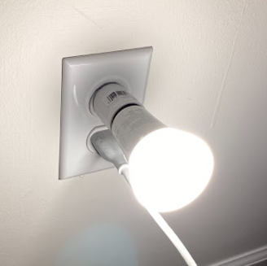
Overview
Goals of the project
Design Approach
Hardware Approach
Software Approach
Test and Analysis
Hardware Software
Software Approach
Summary of Results
Results
Demonstration
Conclusion

Slide 4
Goals of the Project

Slide 5
Desired Goals
Device that can:
Turn smart light on/off based on motion
Turn smart light on/off based on touch
Turn smart light on/off via web app
Dim and turn smart light on/off based on ambient light levels

Slide 6
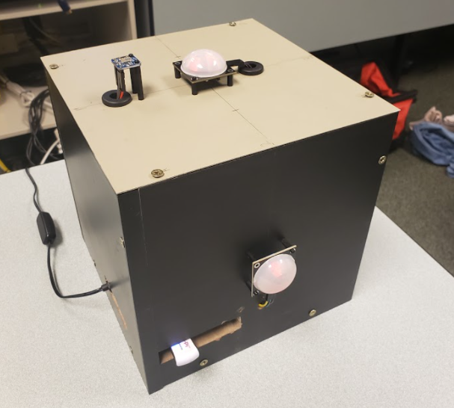
Our Design to Achieve Goals
Developed smart home lighting device capable of analyzing surroundings and user input
Consists of:
Hardware
Microcontroller, sensors, wires, breadboards
Particle board, nylon spacers, wood screws
Software
Android application
Web application

Slide 7
Design Approach: Hardware & Software

Slide 8
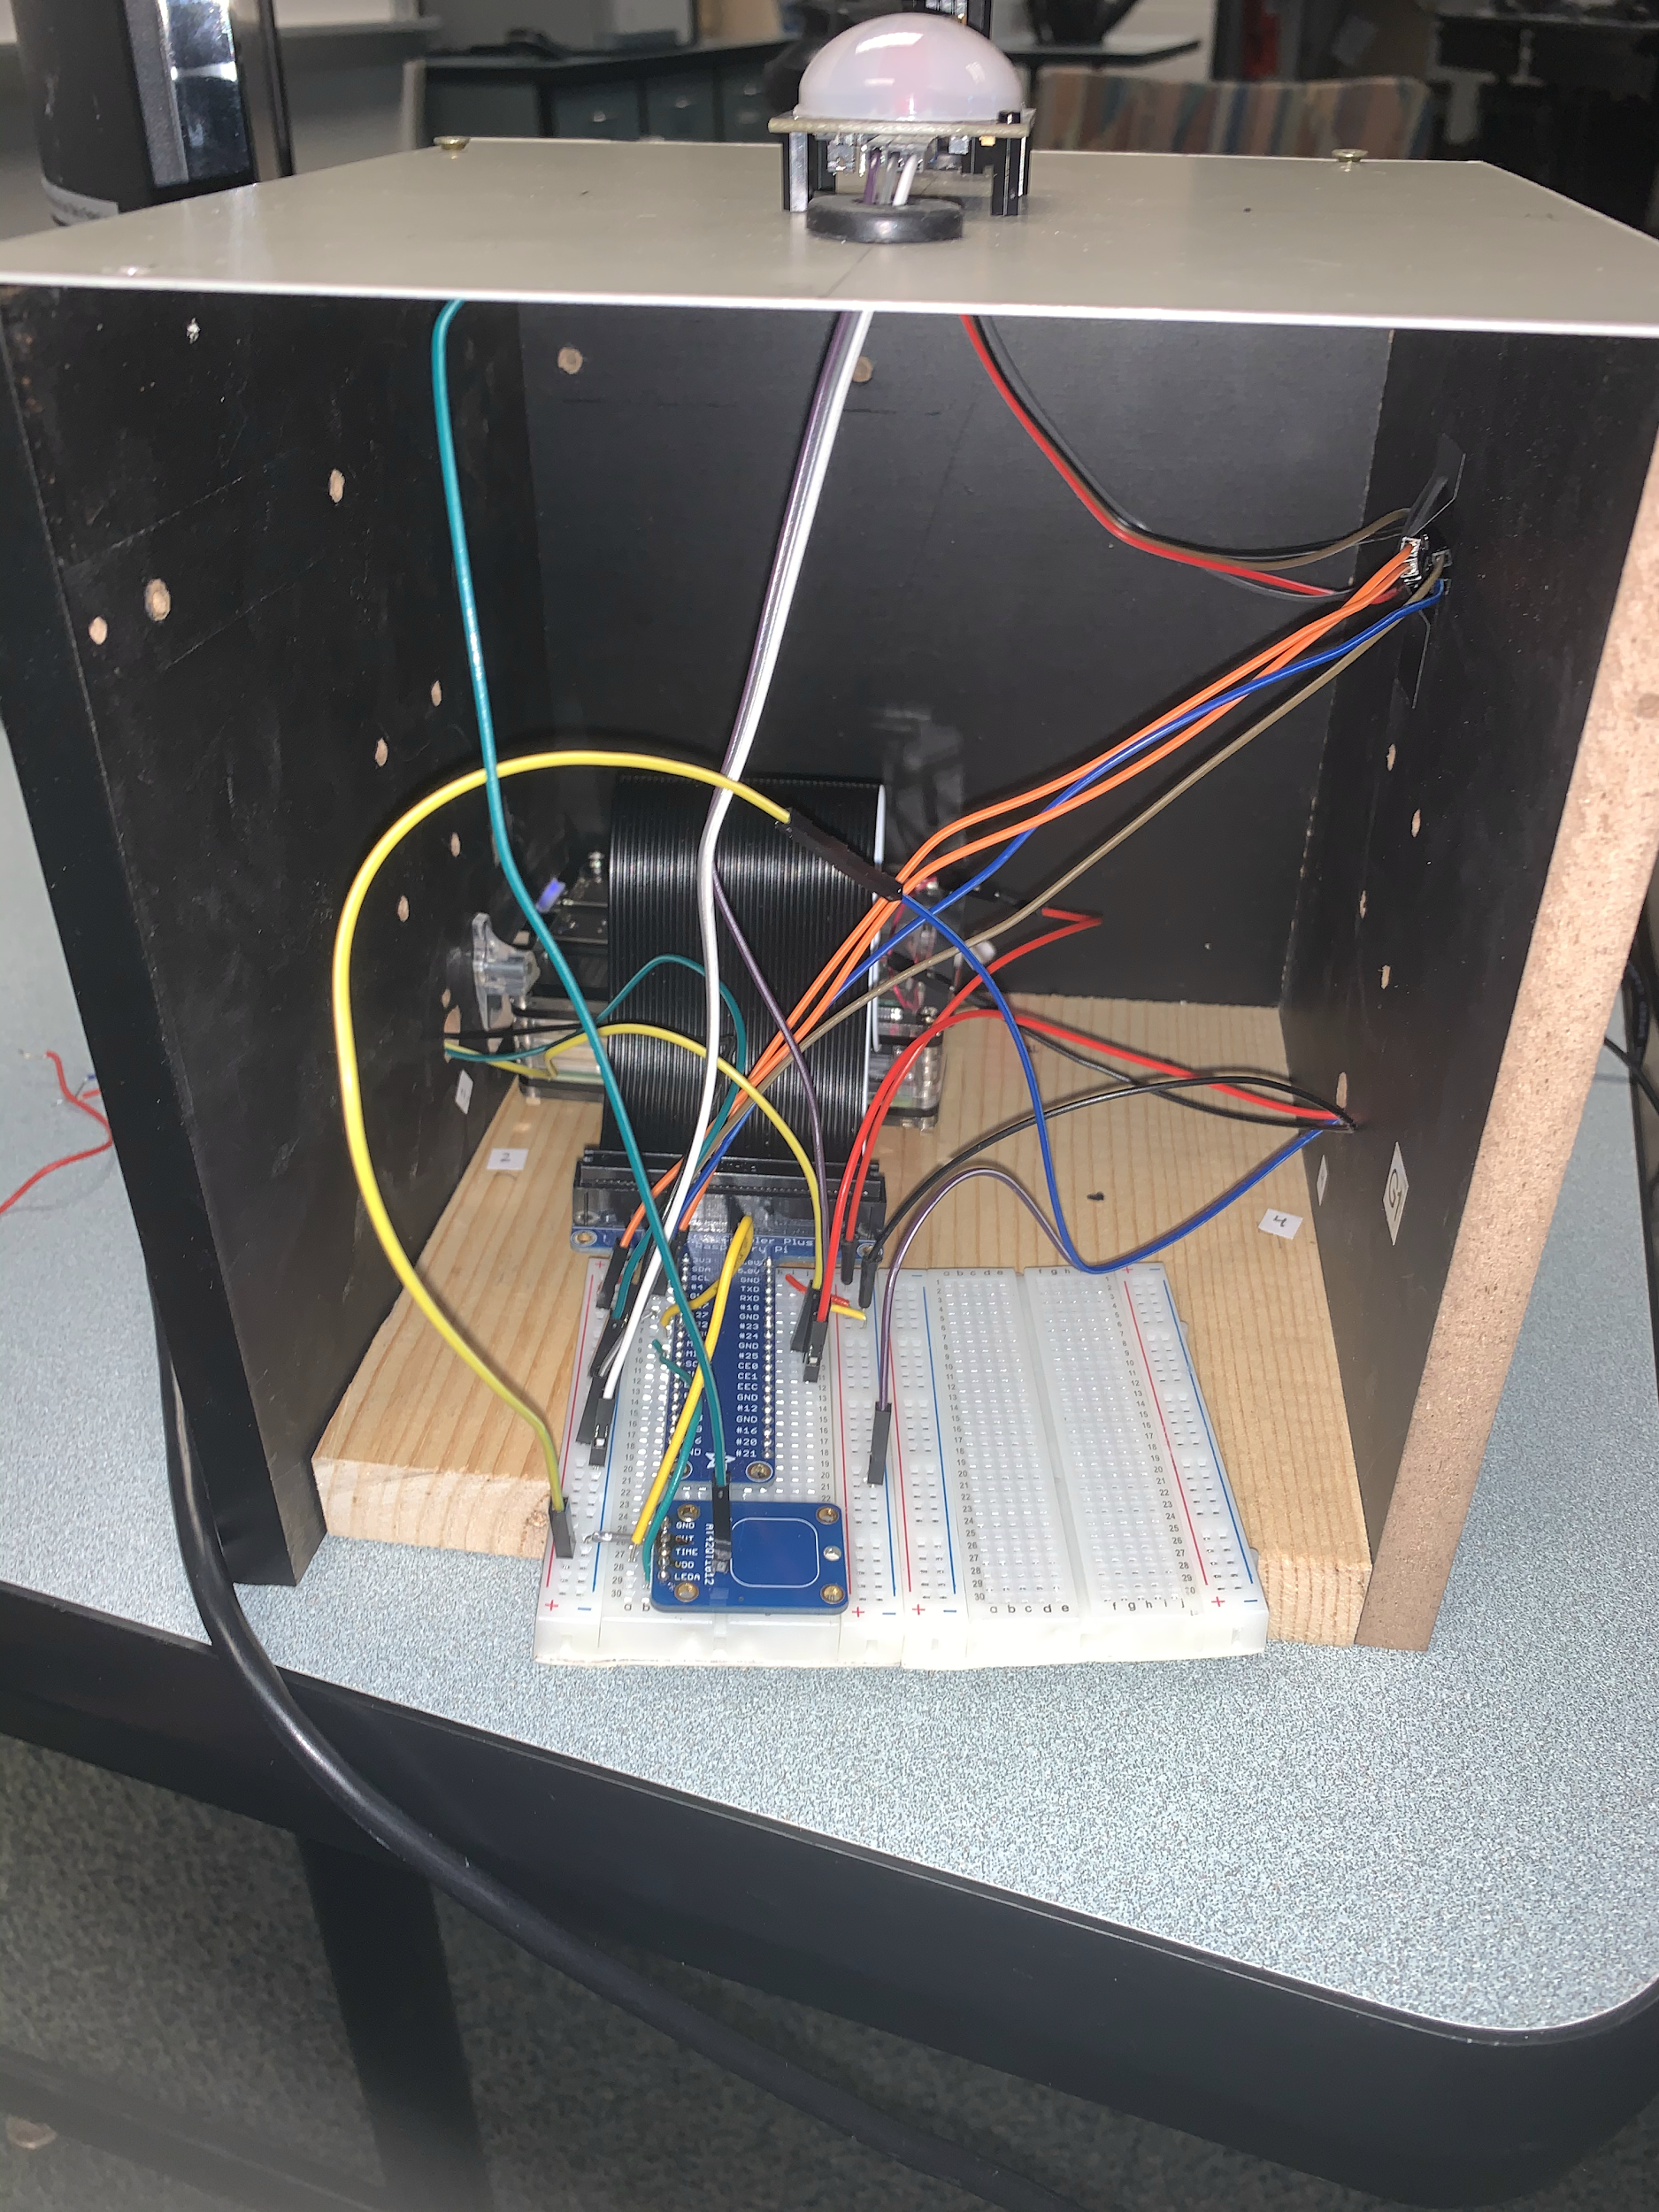
Hardware
Device Enclosure
Particle board
Nylon spacers
Wood Screws
Internal Device Hardware
Microcontroller: Raspberry Pi 4B
Two 400 point breadboards
22 AWG circuit wire
Breakout board
Touch sensor
External Device Hardware
Three motion sensors
One light sensor
Raspberry Pi outlet adapter
Smart Bulb

Slide 9
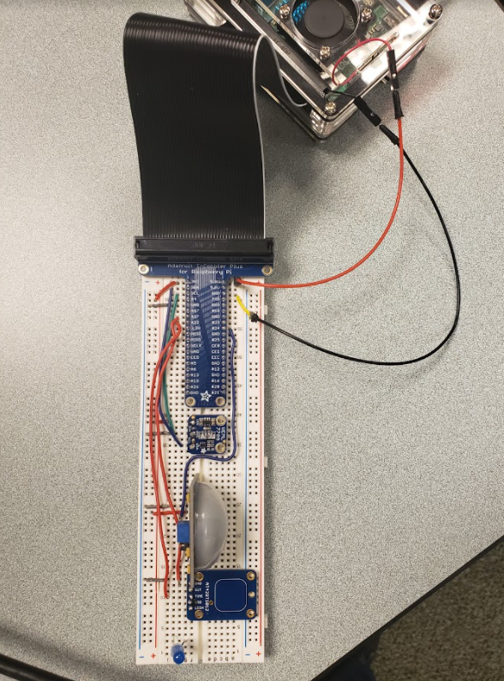
Hardware
Method for hardware design
Prototyping
Testing sensors, microcontroller, and other components
Testing without enclosure and on one board
Components
Our project is made up of multiple components to operate
Circuits and analysis
Setting up and adjusting wiring structure and placement for design

Slide 10
Software
Three Python files:
lightbulb.py - serves a BlueZ bluetooth service and establishes a bluetooth connection with the Philips Hue smart bulb. This file holds the bulb on/off and brightness change functions and is referenced by server_setup.py.
server_setup.py - serves a static html web server, then performs bulb state/brightness changes based on post requests and sensor input.
sensor_data.py - reads sensor inputs (light sensor, motion sensor, and touch sensor) constantly. This file is referenced by server_setup.py.
One CSV file:
history.csv - stores historical data including time/date of bulb state change, type of state change (on/off or brightness change), medium of change, and brightness value.
One HTML file:
index.html - static html code that displays the necessary buttons/input fields for user control. Also displays historical brightness changes..

Slide 11
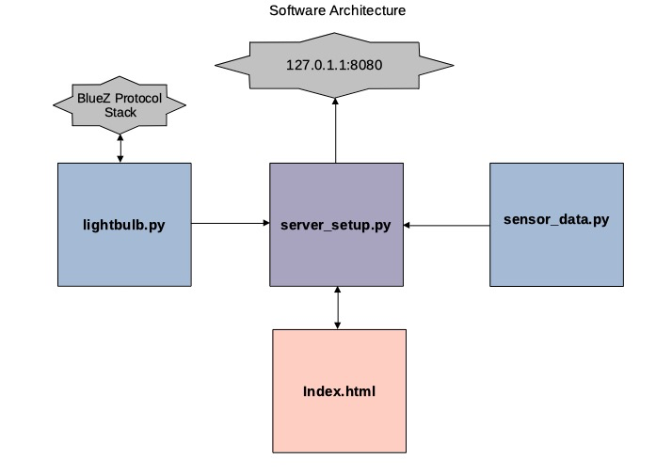
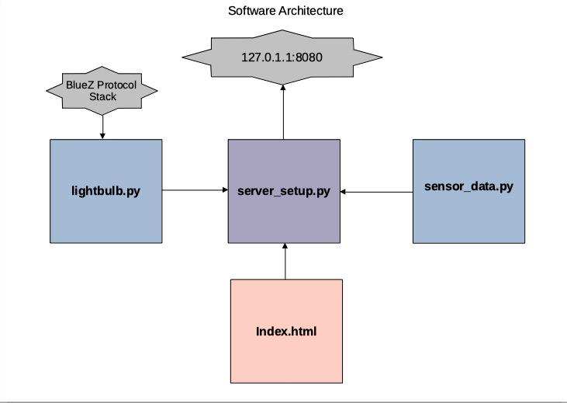
Method for Software Design

Slide 12
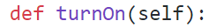
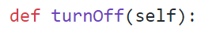
Lightbulb Class
Bluetoothctl is a utility used to establish a bluetooth connection with the bulb upon initialization. Then, Generic Attribute Profile (GATT) services are used to write and read to specific characteristics.
Member data for the status of the bulb, as well as brightness, and the associated methods.

Slide 13
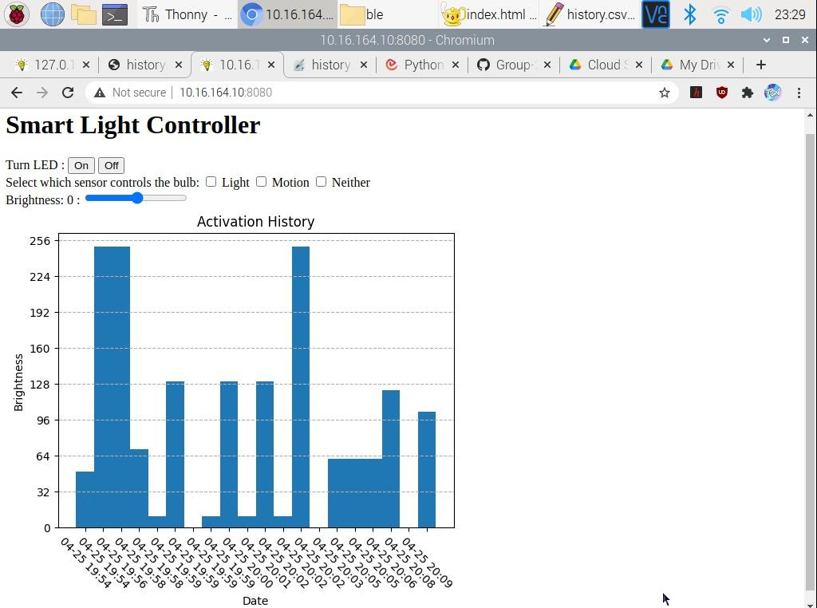

Slide 14
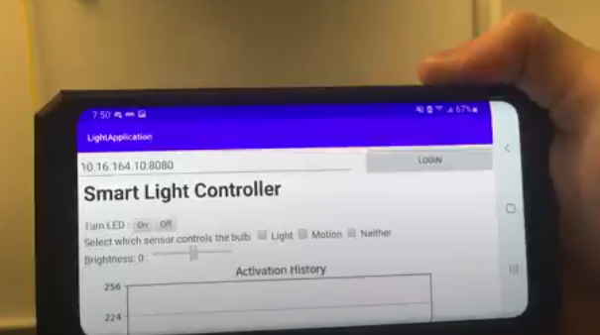
App features
Access webpage for all control options available to desktop users.
Installed on two members phones.

Slide 15
Touch Sensor Algorithm
The following is pseudo-code for how the touch sensor algorithm is implemented in server_setup.py on the Raspberry Pi:
if (touch sensor enabled) and (light bulb is off):
turn_bulb_on()
else if (touch sensor enabled) and (light bulb is on):
turn_bulb_off()

Slide 16
Light Sensor Algorithm
The following is pseudo-code for how the light sensor algorithm is implemented in server_setup.py on the Raspberry Pi:
if (light sensor mode enabled):
bulb_brightness = sensor_data.brightness
The variable brightness (in sensor_data.py) referenced above is defined as below:
light_sensor_output = round(2.5 * light_sensor_output - 1.896e^-14)
brightness = round(-2.5 * light_sensor_output + 250)
These assignments are based on a fit model produced in MATLAB. See the next slide.

Slide 17
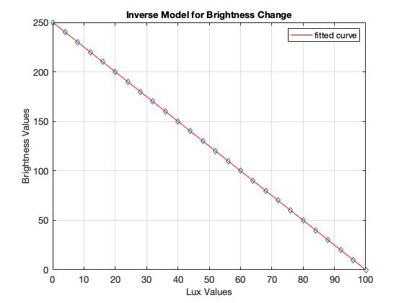
Light Sensor Algorithm
note: fit model produced in MATLAB but implemented in sensor_data.py
Notes:
fitted brightness values (range 0-250) to typical lux values in a room (range 0-100) with an inverse relationship. As lux decreases, the bulb’s brightness increases.

Slide 18
Motion Sensor Algorithm
The following is pseudo-code for how the motion sensor algorithm is implemented in server_setup.py on the Raspberry Pi:
if (motion sensor mode enabled):
if (web ‘Off’ enabled) or (touch sensor enabled):
count_to_30()
else:
turn_bulb_on()
If the bulb is turned off, either through the web app or by touch, the algorithm will wait 30 minutes before returning to its motion sensing mode wherein the bulb is activated if motion is detected.
Notes:
Discuss that count_to_30() locks up the code because current method uses time.sleep() function.

Slide 19
Test & Analysis: Hardware

Slide 20
Bulb activation
Motion Detection
Primary method of analysis: Movement 20ft away activates light
Touch Activation
Primary method of analysis: Touching the top of the device turns on/off light
Light Sensing
Primary method of analysis: Change in room light changes light bulb state

Slide 21
Test & Analysis: Software

Slide 22
Bulb activation
On/Off Toggle
Primary method of analysis: Selecting bulb state (on/off) changes the bulb to that state
Brightness slider
Primary method of analysis: Changing brightness values changes brightness of bulb
Mode select
Primary method of analysis: Bulb is activated only by methods selected

Slide 23
Summary of Results

Slide 24
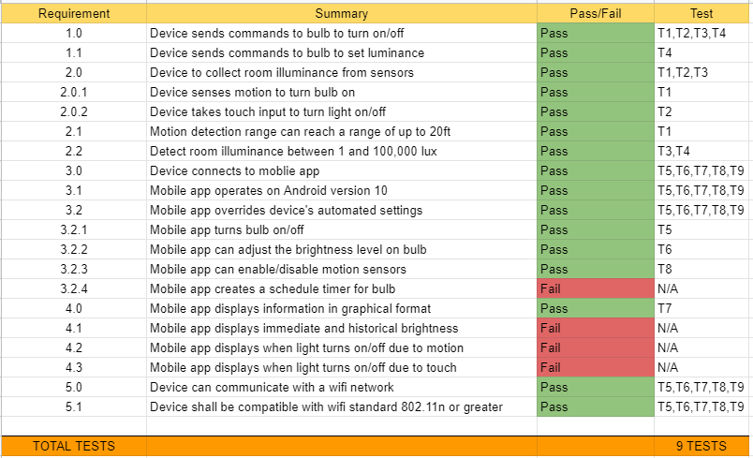
Results
9 Total Tests
Tests: Passed
Motion: 2 tests
Touch: 2 test
Light: 4 tests
Software (app): 1 test
Tests: Failed
Failed requirements were attempting in creation of design but discarded due to time constraints, technical limitation and software implementation

Slide 25
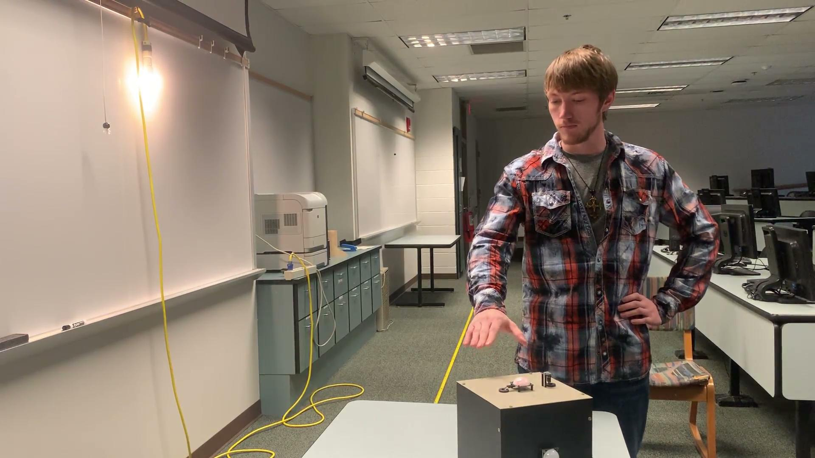
Demonstration: Touch

Slide 26
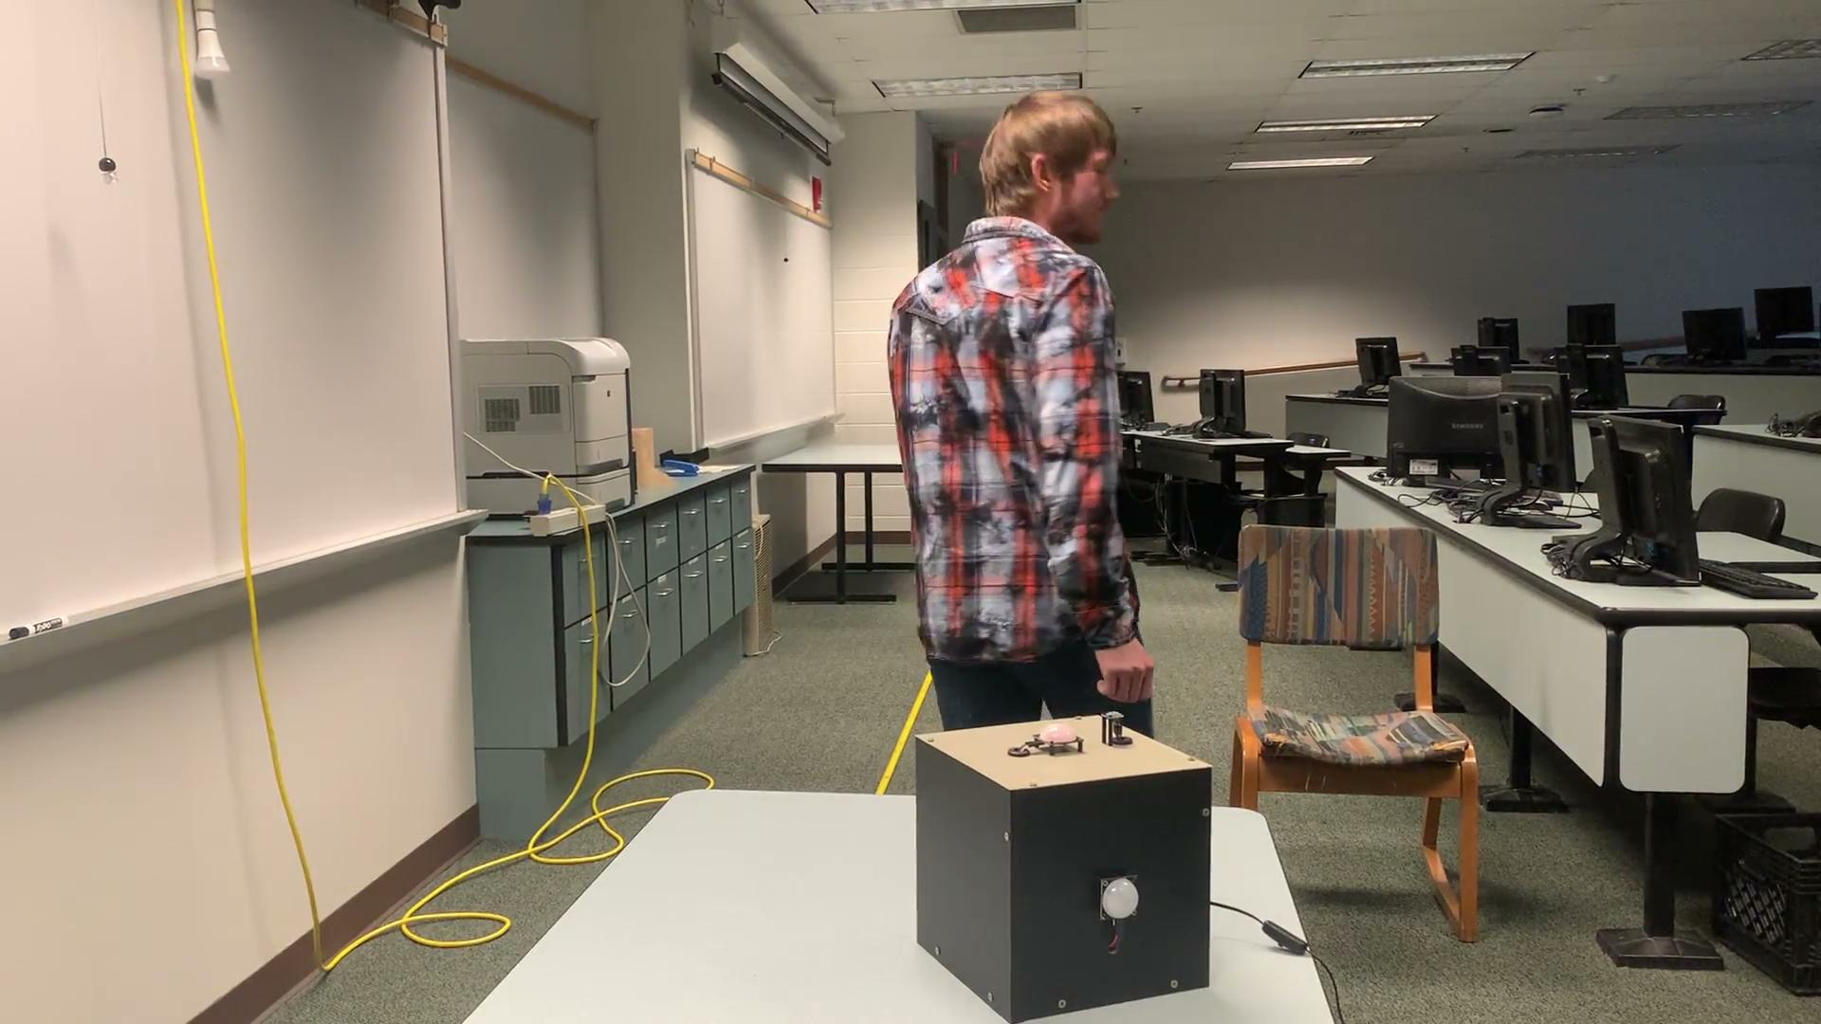
Demonstration: Motion

Slide 27
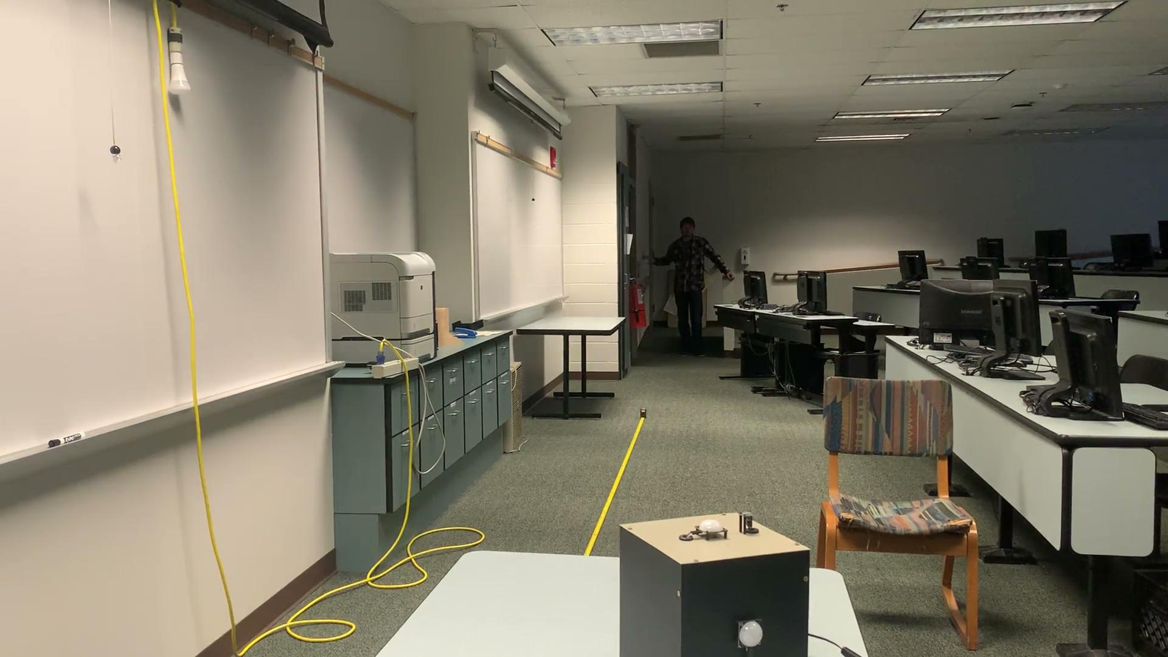
Demonstration: Light

Slide 28
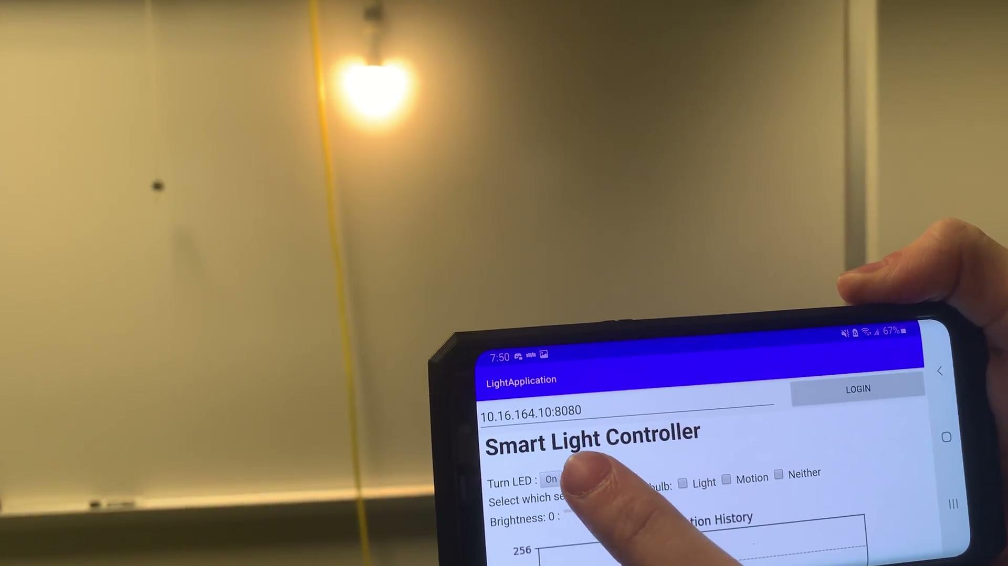
Demonstration: App on/off

Slide 29
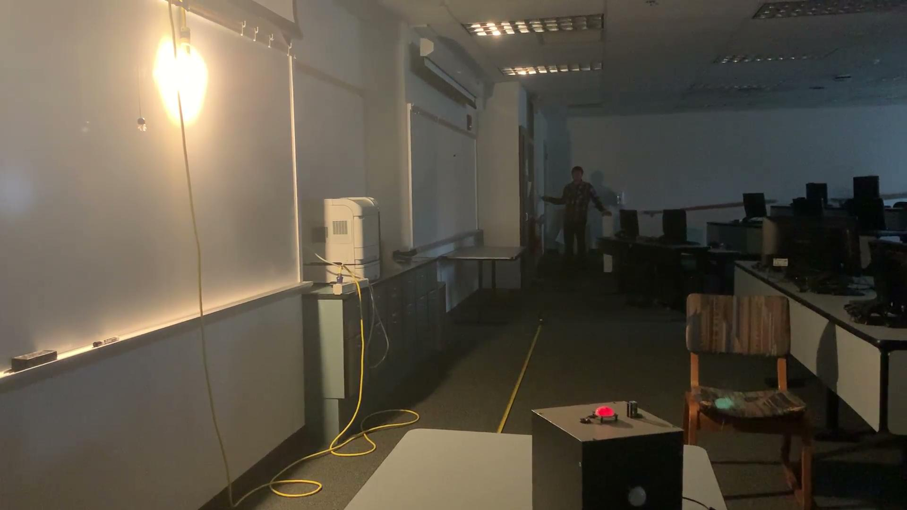
Demonstration: Brightness (via sensor)

Slide 30
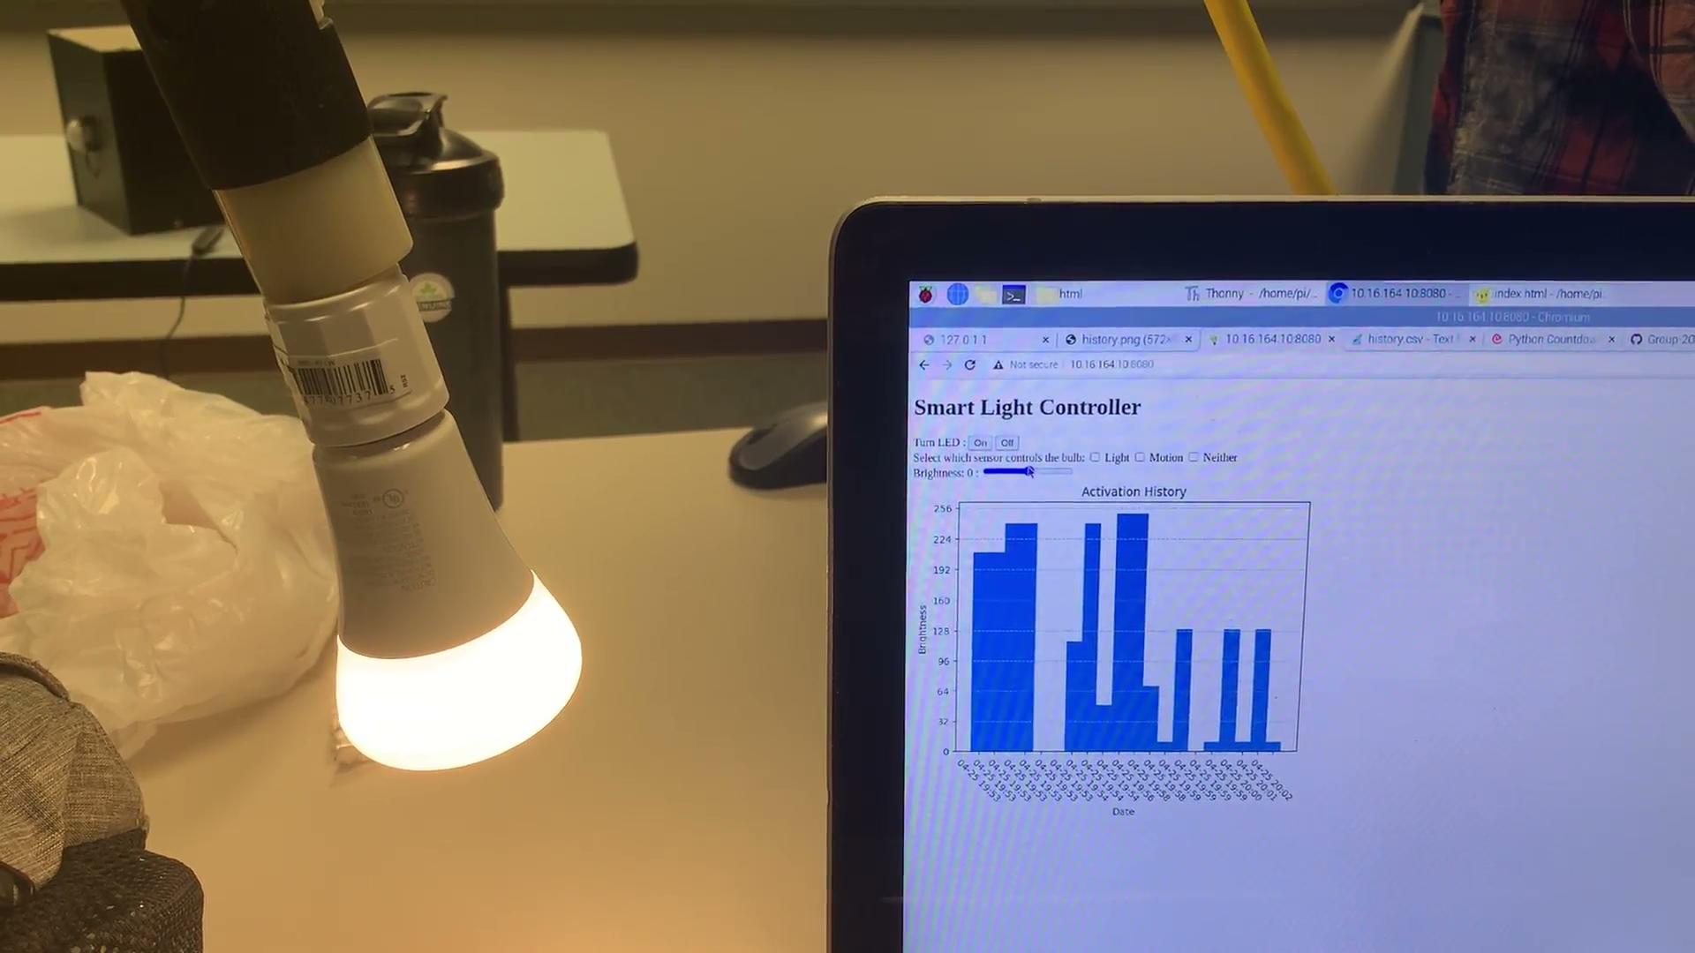
Demonstration: Brightness (via app)
Notes:
Have palmer focus on the bulb

Slide 31
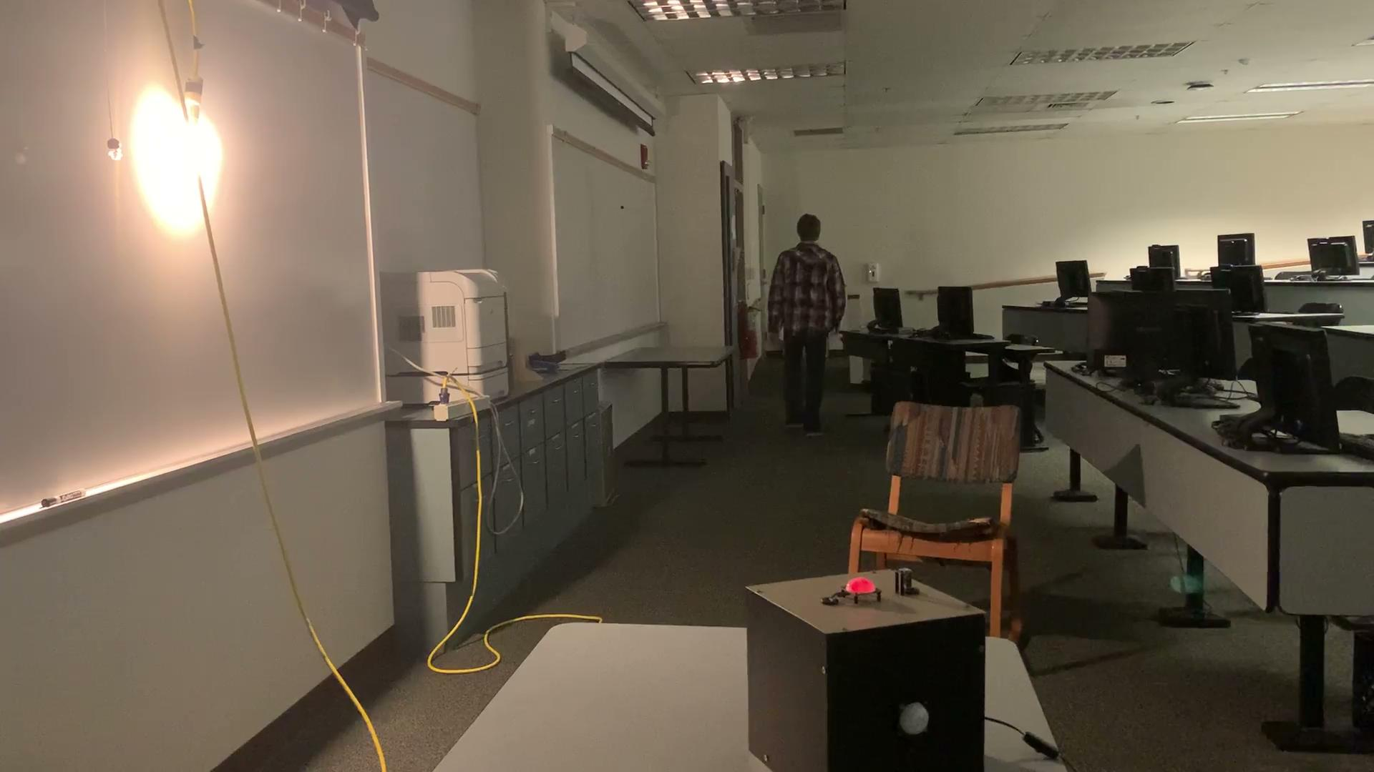
Demonstration: Manual on/off only
Notes:
Notice the red activation light of the motion sensor on top of the box.

Slide 32
Conclusion

Slide 33

What we learned
Hardware
Increase the length of the wire to allow secure strapping and wire runs to breadboard and components.
Use better conductive metal for the top plate to receive the capacitive touch
Software
The server implementation we used was great for rapid prototyping, however it slowed us down when we started adding more depth and functionality. Images were one such issue for us. A dynamic web server needs to be implemented rather than a static one for more functionality.
Ran into issues serving the webpage and detecting sensors at the same time. Multithreading helps fix this issue.
Process
Collaborating online is HARD.

Slide 34
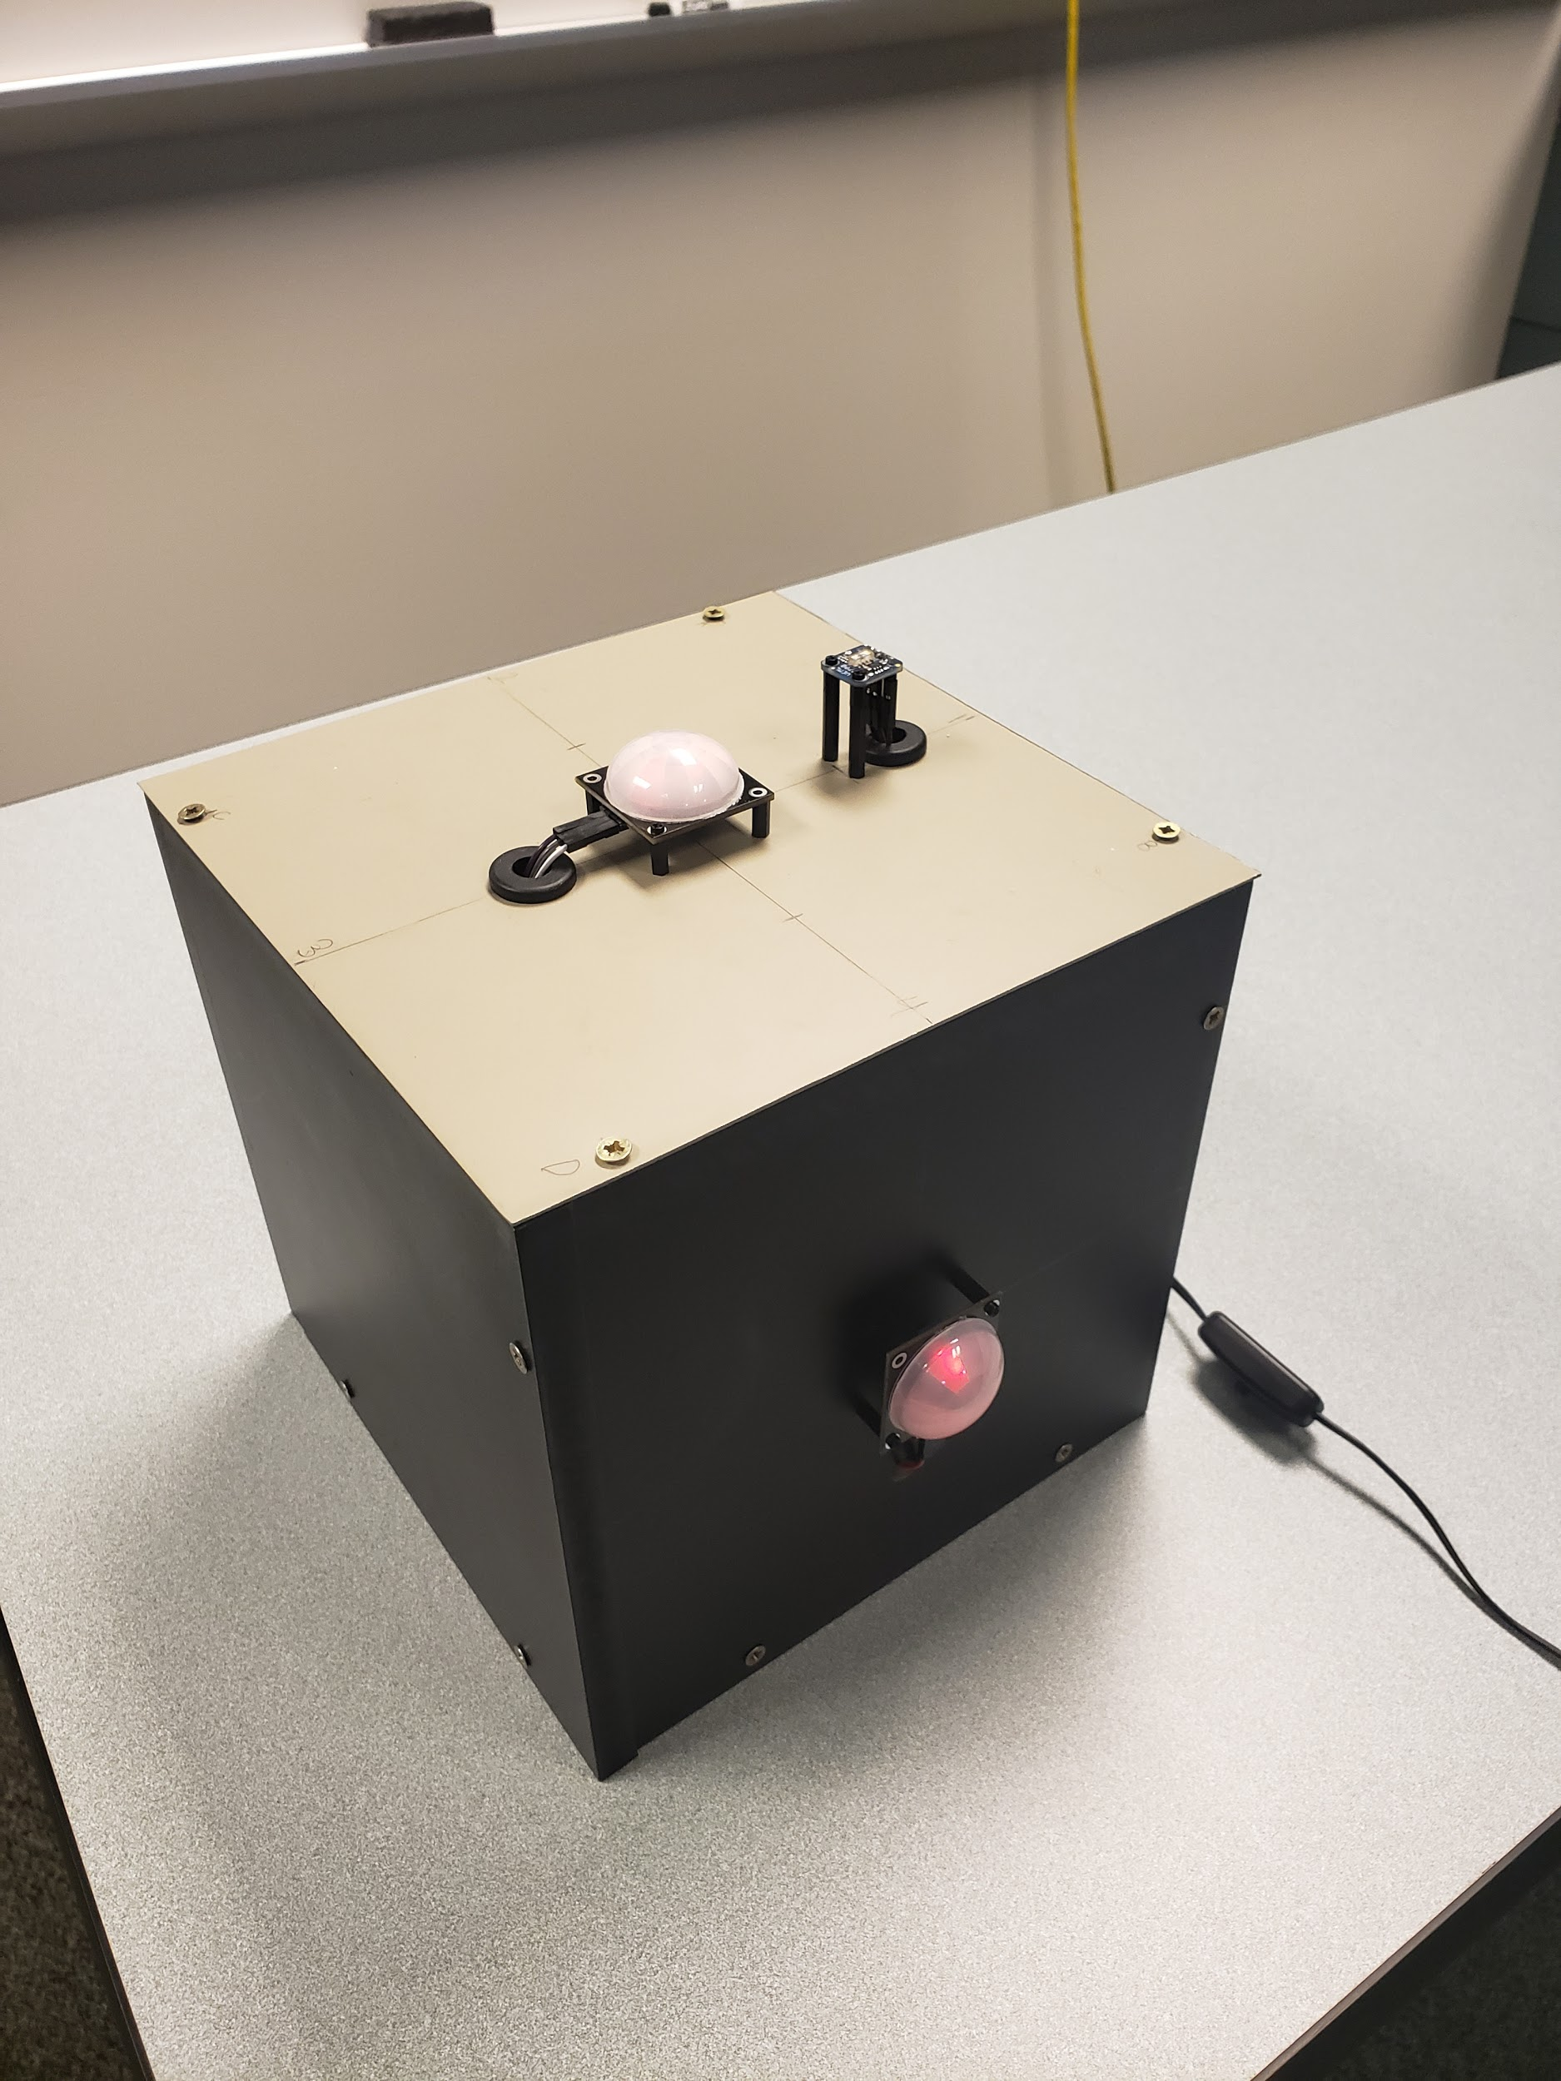
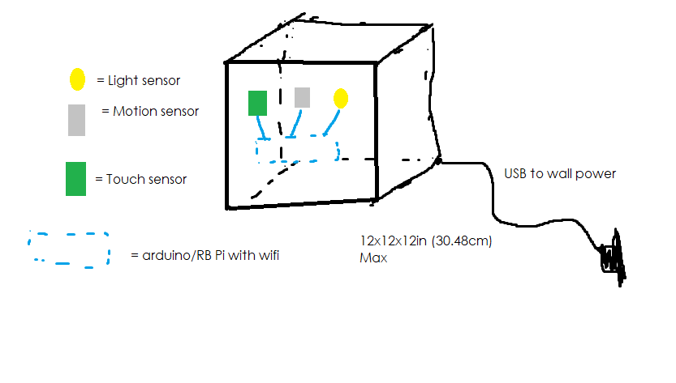
Drawing to reality

